Slide 1
Spirituality & Sustainability
One Christian Approach

Slide 2
SPIRITUALITY
TOWARD AN INCLUSIVE DESCRIPTION:
WHAT WE DO WITH OUR LIFE-ENERGY
or THE “SPIRIT” IN WHICH WE LIVE

Slide 3
ENERGY
UNDIRECTED
CHANNELED

Slide 4
LIFE ENERGY
Everyone who is alive has an energy or life force that drives/empowers everything s/he does from breathing and eating and “sexing” to running marathons, learning languages, building skyscrapers, baking cakes, planting gardens and saving the world…

Slide 5
But even when we are not conscious of “it”, this LIFE-FORCE/ENERGY (SPIRITUS OR ANIMA IN LATIN)
is what keeps all the cells of our bodies working together as a “living organism” and moves and empowers us to do all that we do (the ancients called “it” “the soul”).
When this life force is absent (i.e., when “the soul leaves the body”) all the body parts dis-integrate [except for the calcium phosphate in the form of carbonated hydroxyapatite of our skeletons].

Slide 6
In the WIDEST sense…
SPIRITUALITY can be understood as that which “channels” or directs the life/energy/breath/spiritus within each and every part and particle of the universe.
Healthy Spirituality leads towards integration, freedom, flourishing & fullness of life.
Unhealthy Spirituality leads to dis-integration, destruction, debilitation and death.

Slide 7
WHAT SHAPES MY ACTIONS?
HOW DO I CHANNEL MY DESIRE?
WHAT SORT OF SPIRITUALITY DO I HAVE?

Slide 8
What do I DO with my Life Energy?
List some of the actual things you did yesterday or this morning.
These BEHAVIORS/PRACTICES are part of your personal spirituality.
Look at these behaviors/actions and ask yourself WHY? What values, beliefs/teachings motivated or directed me to channel my energy into doing that instead of something else?
These values, beliefs/teachings, are part of my spirituality.
They derive from my WORLDVIEW: how I see and understand the world (what it is, why it is, what if is for, the role of humanity in it, and my own place in it).

Slide 9
What KIND of spirituality do I have?
How do I spend my “energy,” my time, my “resources” ?
(What do I actually DO with my life?)
What are the values/beliefs that direct me to live this way?
If my life’s actions, values and worldview are consistent with the actions, values and worldview of Jesus of Nazareth, my spirituality (lifestyle and behavior) can be said to be “Christian.”
If they are consistent with the values espoused by my political party or particular denomination or religious order my spirituality can be characterized as “Socialist” or “Presbyterian” or “Dominican” or “Franciscan”
If they are consistent with the principles and practice of Sustainability, I have a Sustainability or Eco-Friendly, Earth Spirituality.

Slide 10
Our working description of SPIRITUALITY…
“What we do with the LIFE ENERGY/SPIRITUS within us”
or
“How we direct (what we use to direct, channel, use) the LIFE ENERGY within us”.
Our Worldview, Beliefs, Values, Practices, Behaviors, Ideals or Goals guide or direct what we do with our life energy-- they determine what kind of spirituality we have.

Slide 11
SUSTAINABILITY
TOWARD A COMMON DESCRIPTION

Slide 12
SUSTAINABILITY
1. the ability to be sustained, supported, upheld, or confirmed.
Environmental Science. the quality of not being harmful to the environment or depleting natural resources, and thereby supporting long-term ecological balance: http://www.dictionary.com/browse/sustainability
“Meeting the needs of the present without compromising the ability of future generations to meet their own needs.” 1983 Brundtland Commission of the U.N.

Slide 13
SUSTAINABLE
1. capable of being sustained
2a. of, relating to, or being a method of harvesting or using a resource so that the resource is not depleted or permanently damaged <sustainable techniques> <sustainable agriculture>
2b. of or relating to a lifestyle involving the use of sustainable methods <sustainable society>
http://www.merriam-webster.com/dictionary/sustainable

Slide 14
A SUSTAINABLE COMMUNITY
is economically, environmentally, and socially healthy and resilient. It meets challenges through integrated solutions rather than through fragmented approaches that meet one of those goals at the expense of the others. It takes a long-term perspective – focused on both the present and future.
manages its human, natural, and financial resources to meet current needs while ensuring that adequate resources are equitably available for future generations.
http://www.iscvt.org/impact/definition-sustainable-community/

Slide 15
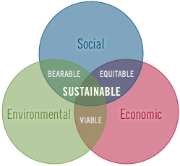
Notes:
Oberlin College follows a general definition that is derived from the widely-cited 1983 Brundtland Commission of the U.N. definitions of sustainable development, which defines sustainability as:
“Meeting the needs of the present without compromising the ability of future generations to meet their own needs”.
Oberlin recognizes three dimensions of sustainable systems (e.g. institutions, communities, regions, countries etc.). They must be
Environmentally sound
Socially just
Economically viable
A consideration of the intersection between these dimensions is fundamental to both assessment and promotion of sustainability.

Slide 16
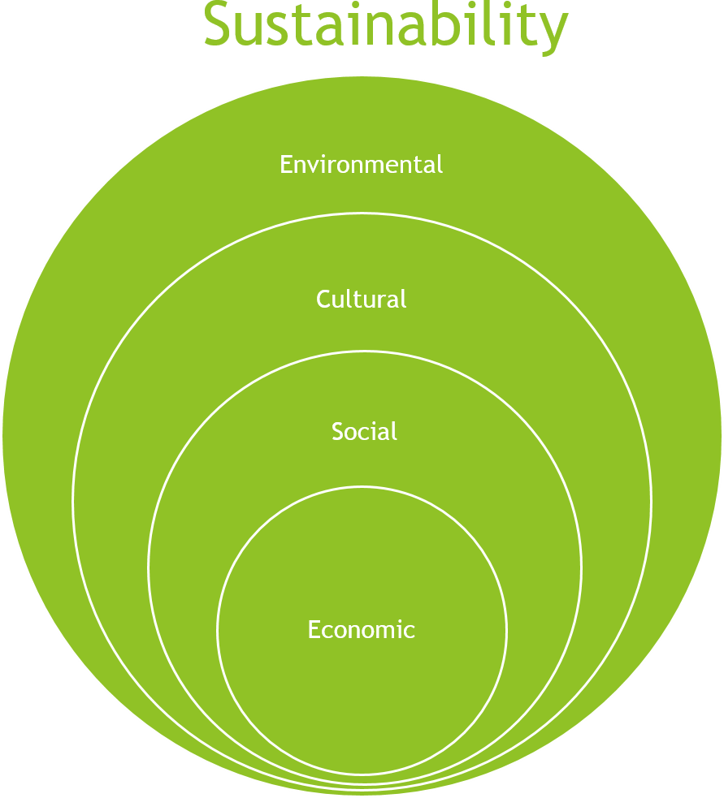
Farmished.org
Notes:
FARMISHED. Our cause is to promote a local, sustainable food system.
Here is the definition we will use when considering our success. Sustainability is composed of four aspects.
Economic
The economic aspect means that the system is using its resources to provide necessary and desirable products and services for the present generation without compromising the ability of future generations to do the same.
Social
The social aspect is about equity within and between generations and within and between ethnic and social groups. This aspect also includes people’s mental and physical well-being and cohesion of their communities based on fair distribution of natural resources.
Cultural
The cultural aspect is about the nourishment and sharing of attitudes and values that represent diverse ways of viewing the world. This aspect includes the political aspect which is about citizens having the opportunity to express their views freely and participate in decision making.
Environmental
The environmental aspect is about the overall viability and health of our living systems. This applies to both natural and managed systems
With the understanding of these components of sustainability, one can understand and appreciate the challenges and needs for a local food system that meets these criteria to be nurtured and promoted.

Slide 17
United Nations Sustainable Development Goals

Slide 18
A SUSTAINABLE SPIRITUALITY
SUSTAINABLE LIFESTYLE/CHOICES/PRACTICES/BEHAVIORS
Guided or Directed by
VALUES/BELIEFS/PRINCIPLES OF SUSTAINABILITY
That arise from an
ECO-THEOLOGICAL WORLDVIEW
Informed by the
Natural, Environmental and Social Sciences,
Christian Biblical, Theological, Moral Studies;
The Ecological Wisdom, Teachings and Insights of other Religious and Indigenous Spiritual Traditions;
Lived experience of individuals and communities.

Slide 19
Do I have a Spirituality that is Sustainable?
What do I actually DO that is eco-sustainable?
What do I DO BECAUSE it is more eco-sustainable than something else?
How often does “Eco-friendly” take precedence over “Convenient” or “Faster”?
Am I conscious of the eco-effects of my shopping, eating, drinking, driving…
Do I spend time, energy, resources learning about sustainability, ecology, eco-theology, eco-spirituality…

Slide 20
Spiritual Practices/Daily Behaviors
FOOD Organic Gardening, Composting, Harvesting, Preserving
Local Produce (10 - 500 feet from kitchen), Slow Food, Semi-vegetarianism…
RECYLING glass, plastic, metal, paper (e-books and e-course materials, assignments…)
ENERGY Solar Panels, Insulation, Wood-burning stove
Electricity (lighting, appliances, technology)
WATER laundry, dishes, shower, toilet, cleaning, gardening
TRAVEL Biking year round, limit use of gasoline (limit travel)
SHOPPING second-hand or recycled; prepare homemade “edible” gifts rather than purchase consumer “stuff”

Slide 21
ECO-THEOLOGICAL WORLDVIEW
Biblical Studies & Theological Perspectives on Creation
Patricia K Hull, INHABITING EDEN
Carol Dempsey,OP & Mary Margaret Pazdan, OP. EARTH, WIND & FIRE
Theology
Darby Kathleen Ray, ed. THEOLOGY THAT MATTERS
Sallie McFague, THE BODY OF GOD: AN ECOLOGICAL THEOLOGY
Environmental Ethics
Leonardo Boff, CRY OF THE EARTH, CRY OF THE POOR
J. Martin-Schramm & R. Stivers, CHRISTIAN ENVIRONMENTAL ETHICS
Pastoral Eco-Theology
Francis of Rome, LAUDATO SI’: ON CARE OF OUR COMMON HOME

Slide 22
Christian Eco-Sustainability
The Forum on Religion and Ecology at Yale
http://fore.yale.edu/religion/christianity/links/
The Daily Feast: Linking Saints, Soups & Sustainability
http://thedailyfeast.org
HUNDREDS of other organizations and websites…

Slide 23
INTERFAITH ECO-ORGANIZATIONS
INTERFAITH POWER AND LIGHT
http://www.interfaithpowerandlight.org
WISCONSIN INTERFAITH POWER AND LIGHT
http://wisconsinipl.org

